Slide 1
Computer, Data and Network / E-Security
Course Instructor:
Dr. Md. Shariful Islam
Professor, IIT, DU
shariful@iit.du.ac.bd
Introduction
1-1
Notes:
1

Slide 2
Suggested Readings
Text Book:
1.Cryptography and Network Security : Principles and Practice (5th edition) by William Stallings
2. Computer Security : Principles and Practice by William Stallings and L. Browne
Introduction
1-2
Notes:
2

Slide 3
Course Administration
Mid Terms (20 Marks) [Avg ]:
Prescheduled Mid# 1 – 20 marks
Prescheduled (if possible) Mid#2 – 20 marks
Only average marks will be counted
Home Works / Assignments (20 Marks)
Class Attendance (10 Marks)
Lab : (50 Marks)
Final Examination (50 Marks):
1-3
Notes:
3

Slide 4
AgenDa
Overview of Network security
Security Goals
Security Mechanisms
Security Services

Slide 5
Network security
field of network security
how bad guys can attack computer networks?
how we can defend networks against attacks?
how to design architectures that are immune to attacks?
Internet not originally designed with (much) security in mind
original vision: “a group of mutually trusting users attached to a transparent network”
Internet protocol designers playing “catch-up”
security considerations in all layers!

Slide 6
Information Security deals with
Security of end systems
Examples: Operating system, files in a host, databases, accounting information, logs, etc.
Security of information in transit over a network
Examples: e-commerce transactions, online banking, confidential e-mails, file transfers, etc.

Slide 7
Some terminologies
Threat
Vulnerability
Control
Set of circumstances that has the potential to cause loss or harm
a weakness in the security system (in procedures, design and implementation)
Some protective measures

Slide 8
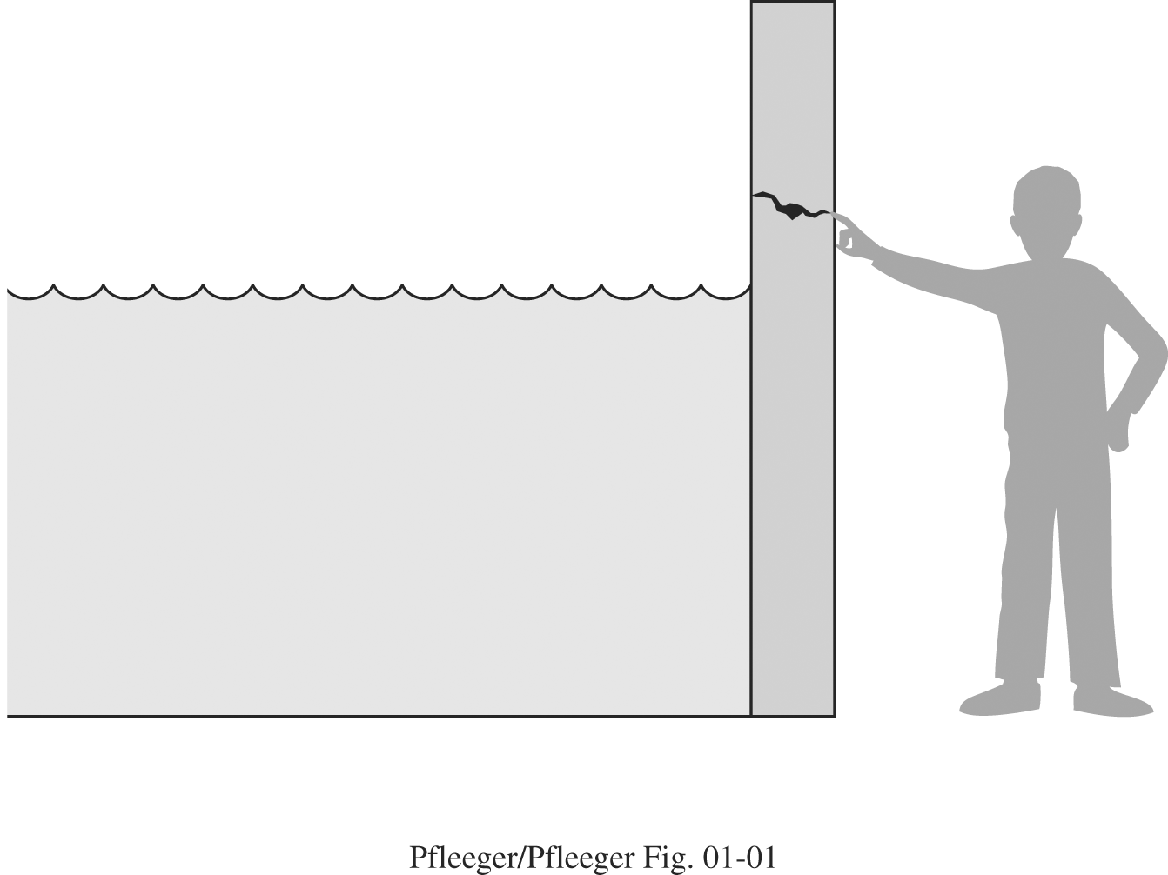
A threat is blocked by control of vulnerabilities

Slide 9
Types of threats
Interception
Un-authorized party gained access to an asset.
Illegal copying of program or data.
Example: Wiretapping to obtain data in a network.
Interruption
an asset of the system become lost, unavailable or unusable.
Hardware failure
Operating system malfunction
Example Erasure of a program or data file

Slide 10
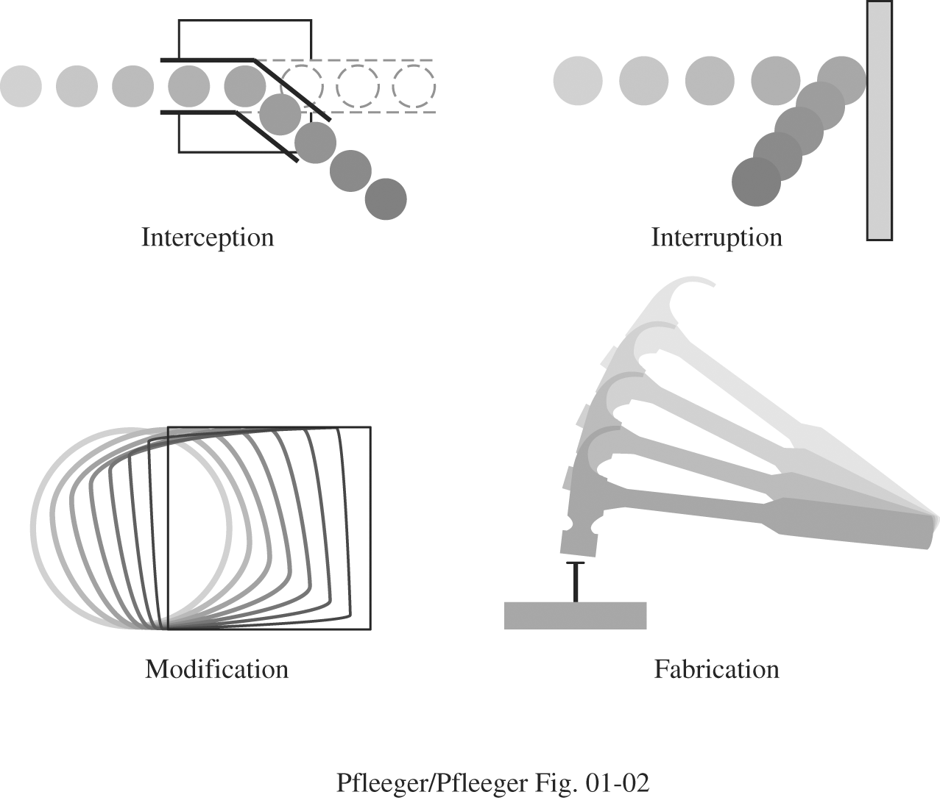
Types of threats (CONT.)

Slide 11
Types of threats (cont.)
Modification
Not only an-authorized access, but tampers with an asset.
Example: Alteration of data
Fabrication
Addition of imaginary information to a system by an un authorized party.
Example: addition of a record to an existing database

Slide 12
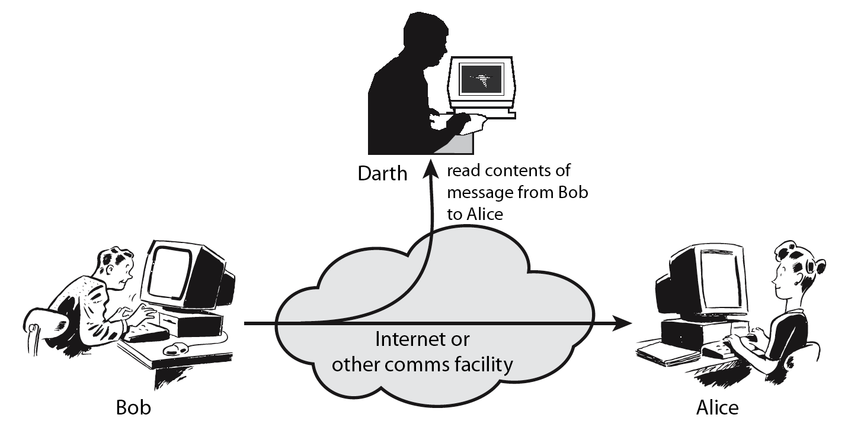
Passive attack

Slide 13
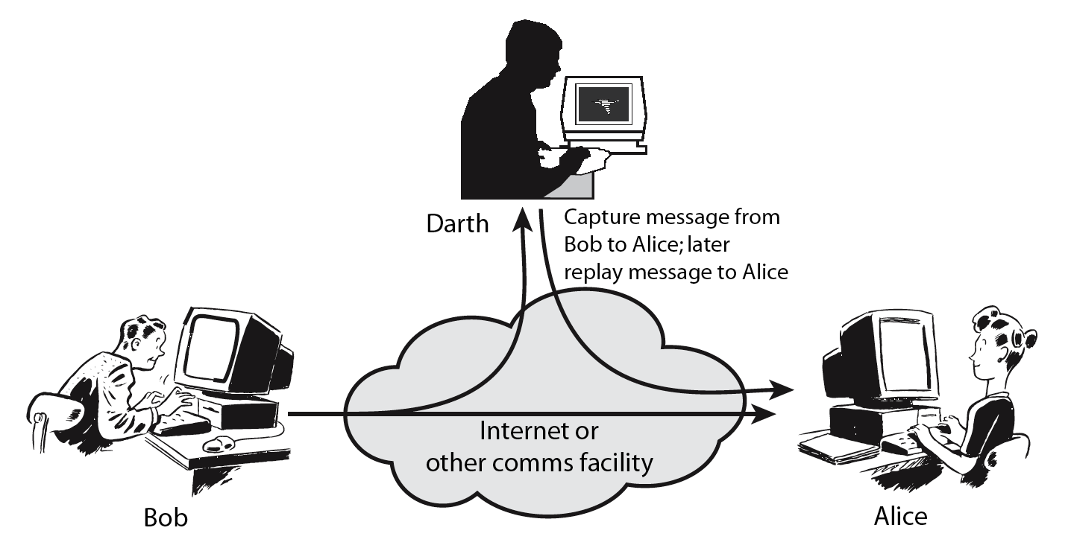
Active attacks

Slide 14
Security goals (CIA)
Confidentiality
Keeping data and resources secret or hidden.(secrecy or privacy)
Only authorized party can access information.
access does not mean write but allows to read, view or print information.
Integrity
Assets can be modified only by authorized parties or only in authorized ways.
Modification writing, deleting, creating, changing etc.
Availability
Ensuring authorized access to data and resources when desired
Confidentiality
Integrity
Availability

Slide 15
Security Services and Mechanisms
Services
enhances the security of the data processing systems and the information transfers of an organization.
intended to counter security attacks
make use of one or more security mechanisms to provide the service.
Mechanisms
A mechanism that is designed to detect, prevent, or recover from a security attack

Slide 16
Security Services
Authentication
have both peer-entity & data origin authentication
Access Control
Data Confidentiality
assurance that communicating entity is the one claimed
prevention of the unauthorized use of a resource
protection of data from unauthorized disclosure

Slide 17
Security Services
Data Integrity
Non-Repudiation
Availability
assurance that data received is as sent by an authorized entity
protection against denial by one of the parties in a communication
resource accessible/usable

Slide 18
Security mechanisms
Enchipherment
The use of mathematical algorithms to transform data into a form that is not readily intelligible.
Digital Signature
Access Control
Data Integrity
Data appended to, or a cryptographic transformation of, a data unit that allows a recipient of the data unit to prove the source and integrity of the data unit and protect against forgery (e.g., by the recipient).
A variety of mechanisms that enforce access rights to resources.
A variety of mechanisms used to assure the integrity of a data unit or stream of data units
Symmetric and public key encryption mechanisms.
Digital Signature Standard (DSS) or RSA based algorithms.
Discretionary Access Control (DAC) , Role Based Access Control (RBAC) etc.
MD5. SHA etc.
DES, 3DES, AES, RSA, etc

Slide 19
conclusion
Discussed about
Information security
Security requirements and threats
Security services and mechanisms

